Slide 1

ARTIFICIAL INTELLIGENCE NATURAL LANGUAGE PROCESSING(NLP) SENTIMENT ANALYIS PROJECT
A Complete Project on
IMDB Dataset
Don Valley Advanced Solutions
August 19, 2023
Kulwinder Kaur

Slide 2


INTRODUCTION
Natural language processing (NLP) refers to the branch of artificial intelligence concerned with giving computers the ability to understand text and spoken words in the same way human beings can.
NLP combines computational linguistics—rule-based modeling of human language—with statistical, machine learning, and deep learning models.
NLP allows human beings to have an understandable and interpretable communication with the machine.
The Internet Movie Database (IMDb) is a website that serves as an online database of world cinema containing a large amount of public data such as the detail information, reviews, sentiments and much more on movies from all around the globe.

Slide 3

ARCHITECTURE
IMDB Movies Dataset
50k movie review along with positive/negative sentiment labels
ARCHITECTURE –
SENTIMENT CLASSIFICATION
DATA Preprocessing
Removing numbers, punctuation marks, special char and whitespaces
Word Embedding's
Using GloVe to represent Movie Reviews from text-to-numeric form
Train Models
LSTM Model
Live Predictions
Performing live queries on self movie reviews & seeing how model performs in telling Positive/negative

Slide 4








ON A MISSION…
Industry Ready Projects
With real-life complexity
End-to-end Solution
Deploy model with flask
Introduction
Sentiment
Analysis
Kit includes
Business cases & dataset,
Python code, Tensor flow, Keras, Matplotlib
Business Analysis tools
Solution Architecture
Building Model
Brief on the Project

Slide 5

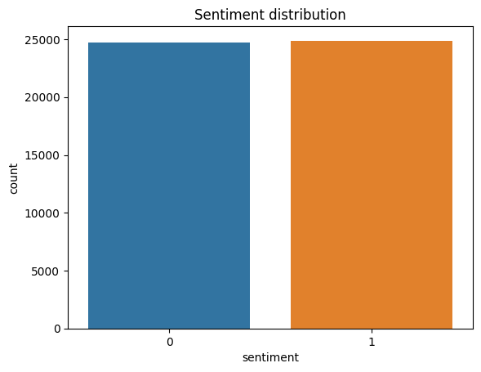
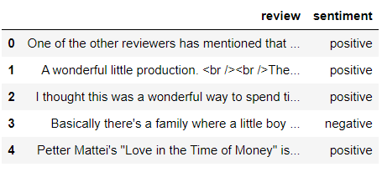
SENTIMENT ANALYSIS
A program can understand whether the sentiment behind a piece of text is positive, negative, or neutral.
Negative Positive Neutral

Slide 6




DATA EXPLORATION
After hunting for data on the internet, we used the IMDB database and an API key to extract raw data. This database contains a large volume of unstructured data which need to be cleaned and structured for use in research and education.
DATA CLEANUP
Remove html, url & non alpha-numeric character
2. Text converted into lower case(lower-cased words would get different embedding's)
3. Cleaning extra spaces
4. Unnecessary marks

Slide 7

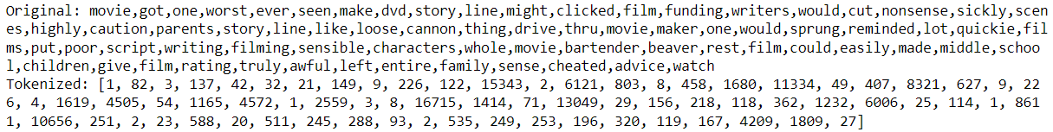
WORD EMBEDDING
To use text data as input to a neural network model, need to convert text to numbers or small dense vectors. Every word represented as a n-dimensional dense vector.
For Example -
Removed Stop words like ‘an’, ‘are’, ‘did’, ‘further’, ‘hasn’t, ‘form’, ‘to’, ‘shouldn’t’ etc.
Filtered words are representing each word as a dense, which is more effective at capturing the meaning of words.
Original means split the sentence into words and creates a dictionary of all unique words.

Slide 8

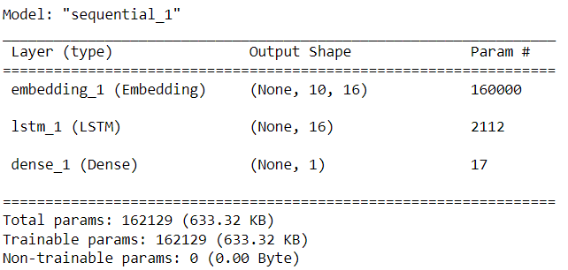
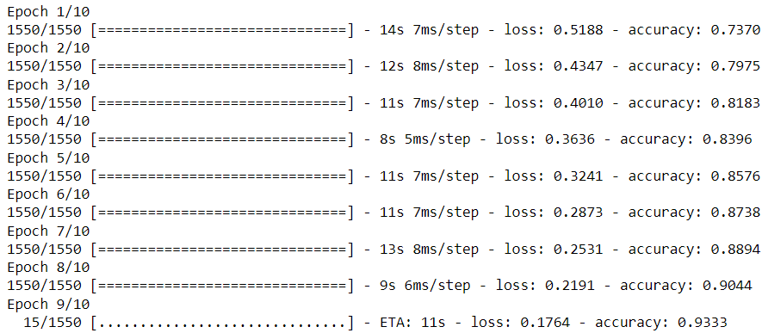

LONG SHORT TERM MODEL (LSTM)

Slide 9

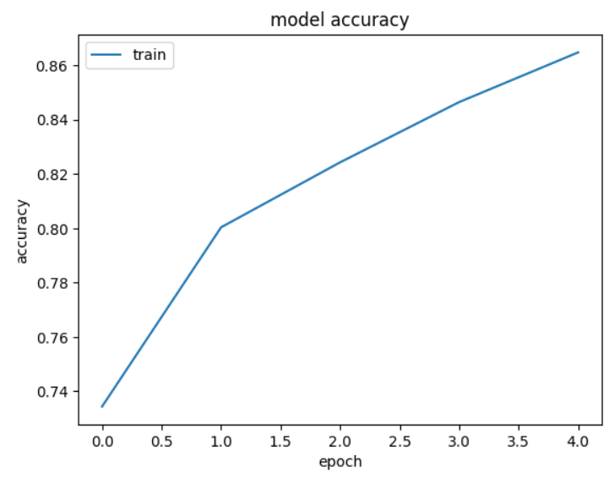
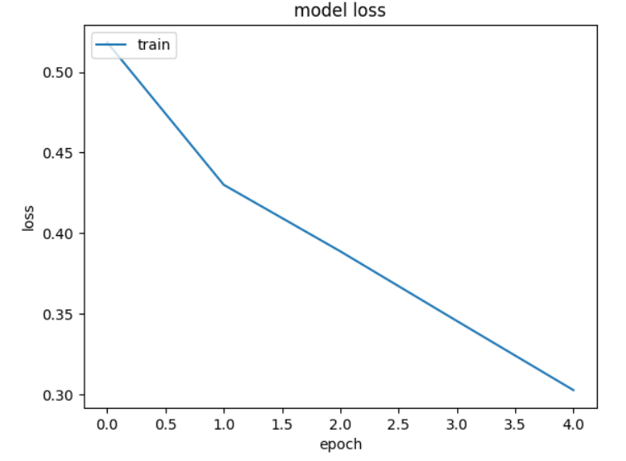
PLOTTING

Slide 10

OUR FINDINGS
Intuition
Capable of learning & remembering patterns across time
Structure
Embedding Layer >> LSTM >> Dense Layer >> Output
Speciality
Memory & Self learning
Data Type
Trained with sequence data
Applications
Machine Translation, Language Modeling and Multilingual Language Processing

Slide 11

CONCLUSION
The LSTM model was able to categorize the sentiments in the test reviews to be either ‘positive’ or ‘negative’ with an approximately accuracy 96%. These accuracy values can further be improved by using a different Neural Network Architecture or Data Pre-processing.

